Slide 1

G FIFA
A Knowledge Representation Technologies Project
Under the supervision of Prof. Edward Holden
Nirbhay Pherwani
Dhiren Chandnani
Yash Rajaram Bagayatkar
Hemanth Kammari

Slide 2
Content
Introduction
Technologies used
Pipeline
Data Cleaning and Insertion into MongoDb
Onto the GUI
PHP Connect
Querying and Wildcard Querying
Future scope

Slide 3
Introduction
Footballers also play the stats game
Our project keeps track of their current progress using the rich database collected by scrapping the web for all the detailed professional information about each individual player.
We have included customized searches according to various general criteria or detailed criteria
We also retrieve geo locations of all the players within a particular radius of a country

Slide 4
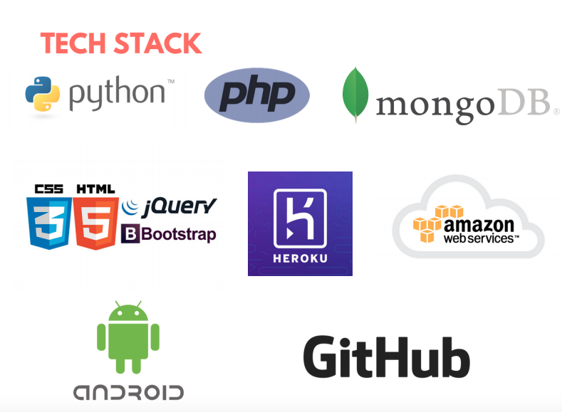
Technologies used

Slide 5
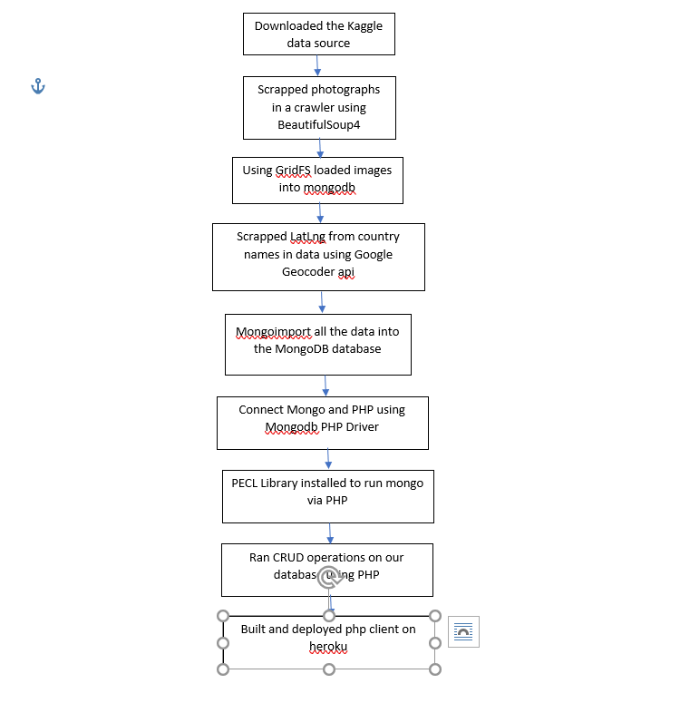
Pipeline

Slide 6
Data Cleaning and insert into Mongodb
The dataset was downloaded from kaggle which is up to date as of the year 2018
The data that we downloaded did not have the images, description, location latlngs
We wrote python scripts to crawl the web for this information

Slide 7
Onto the GUI
GoFIFA GUI has a custom search page which allows customizing search criteria based and returns all the players fitting those criteria
Upon selecting a particular player, we are able to view all the stats and details of the player.
This exposes the player’s strengths, weaknesses, his background and also his picture
The strengths and weaknesses are displayed using a custom stat radar from certain stats present in the mongodb database
Eg: pace= 0.55*sprint speed + 0.45*acceleration

Slide 8
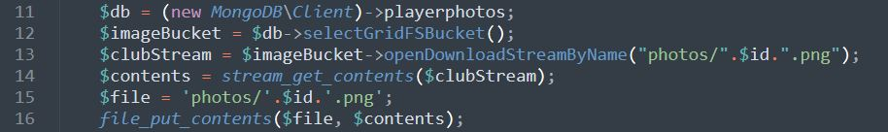

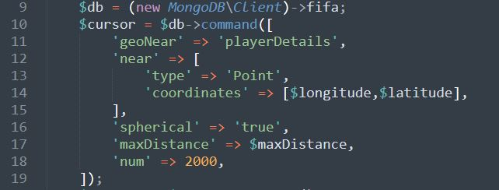
PHP Connect
Fetching Images from GridFS
Finding a particular player
Fetching Player Location

Slide 9
Querying and Wildcard Querying
We also added a feature of not only searching for the whole name typed, but also for a partial word search
This partial word search allows user to view all player names related to the partial word
Wildcard query search is implemented using regex querying command
PHP being lean and light, we used it to create the rest api and make a whole web integration

Slide 10
Future Scope
Adding more features to the geocode

